Slide 1


RAGNO Tim
03/04/2024

Slide 2

Outline
Executive Summary
Introduction
Methodology
Results
Conclusion
Appendix

Slide 3
Executive Summary
Summary of methodologies
The different methodologies I used during this project were : Data Collection, Data Wrangling, Data Visualisation, EDA and Model Development and Evaluation.
Summary of all results
Clean, exploitable Data from the SpaceX launches
Exploratory Data Analysis on this Data
Predictive analysis results

Slide 4
Introduction
SpaceX has revolutionized space exploration with its innovations in cost-effective rocket technology. This data science project aims to analyze SpaceX launches to identify trends and insights related to launch successes, payload capacities, and the impact of reusable rocket technology, contributing to the understanding of SpaceX's influence on the future of space travel.
Problems:
How can SpaceX minimise failures ?
What are the trends and correlations in Payload Size and other variables for example ?

Slide 5

Section 1

Slide 6
Methodology
Executive Summary
Data collection methodology:
Two types of Data Sources : SpaceX API and Wikipedia
Perform data wrangling
Missing values imputation, One-hot encoding, cleaning data…
Perform exploratory data analysis (EDA) using visualization and SQL
Perform interactive visual analytics using Folium and Plotly Dash
Perform predictive analysis using classification models
Data Standardisation
Hyperparameter tuning and Model Evaluation

Slide 7
Data Collection
The Data was collected in two ways : using the SpaceX API and scraping Wikipedia
SpaceX
API
Record features
Launch Site
Payload
Booster Version
DataFrame
Wikipedia
Requests GET
BeautifulSoup

Slide 8
Data Collection – SpaceX API
Data collected through SpaceX’s API
JSON request -> DataFrame
Data Cleaning after
Custom functions are used to fill in the values for some features
SpaceX
API
Requests GET
JSON
Data Imputation
Filter out Falcon 9 launches
DataFrame
Custom
functions

Slide 9
Data Collection - Scraping
Used Requests and BeautifulSoup to extract table content
Custom Python functions are used to extract the right info from the table
GitHub
Wikipedia
BeautifulSoup
Requests GET
Table Content
DataFrame
Custom
functions

Slide 10
Data Wrangling
Data from the previous methods was imported into a DataFrame then modified using Pandas to suit different needs:
Creation of the landing outcome feature
Evaluation of the success rate
GitHub

Slide 11

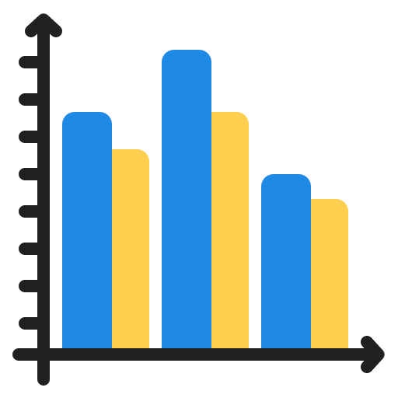

EDA with Data Visualization
Mainly using Seaborn, we visualised the relation between different variables:
Flight Number vs Payload Mass/Launch site using a scatter plot
Success Rate and Orbit Type using a barplot
Success Rate and Year using a line plot
Github
GitHub:

Slide 12

EDA with SQL
Used Magic Functions to use SQL queries in the Jupyter Notebook
Display the names of the unique launch sites in the space mission
Display 5 records where launch sites begin with the string 'CCA'
Display the total payload mass carried by boosters launched by NASA (CRS)
…
GitHub

Slide 13
Build an Interactive Map with Folium
Create various Folium objects to add to a map of the SpaceX launches
Circles and Markers to identify the launch sites
Color on the Marker to identify if they were successful or not
A Marker Cluster to map all the the launches to a single point at lower zoom (avoid clutter)
Polylines to link the launch sites to the nearest landmarks (sea, trains…)
GitHub

Slide 14
Build a Dashboard with Plotly Dash
Unfortunately, due to an issue with the lab link, I was unable to do this one :(. I will thus have no GitHub and no link to a notebook for the Dashboard creation. I looked forward to this one so I am a bit sad.

Slide 15
Predictive Analysis (Classification)
Preprocessed the Data
Split into Train/Test
Fitted a GridSearch on 4 different models for classification
Evaluated them using .score and Confusion matrices
GitHub
Dataframe
Standardisation
(Standard Scaler)
Train/Test Split
(80/20)
KNN
SVM
Confusion Matrix
GridSearch
Logistic Regression
Decision Trees

Slide 16
Results
Exploratory data analysis results
Interactive analytics demo in screenshots
Predictive analysis results

Slide 17

Section 2

Slide 18
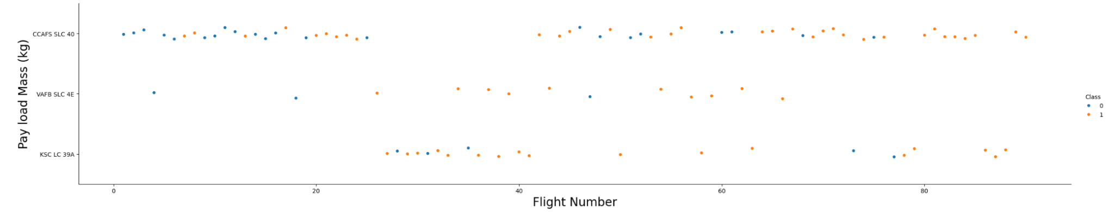
Flight Number vs. Launch Site
We can see that the success rate seems to go up over time
VAFB SLC 4E sees very few launches but seems to get them right very often
Recent launches (in this graph) have been stellar

Slide 19
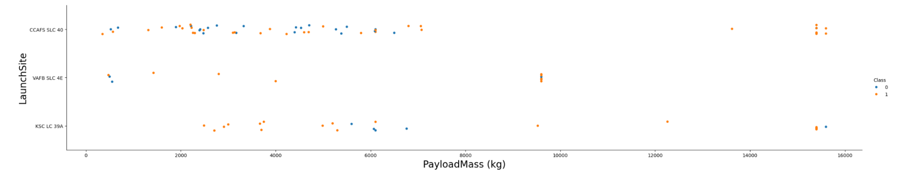
Payload vs. Launch Site
High Payload mass is very rare but seems to get good results on all launch sites
CCAFS SLC 40 seems to struggle the most all across the board (with no relation with Payload mass)

Slide 20
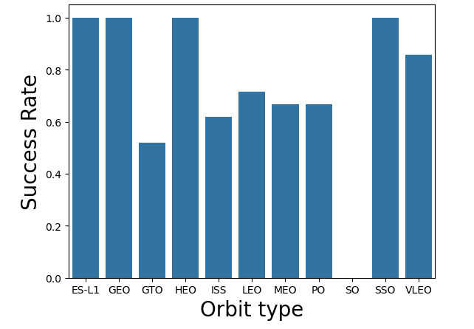
Success Rate vs. Orbit Type
GTO has the lowest SR
Max SR is split between 4 Orbit types (have to see the value counts to really compare the 4)

Slide 21
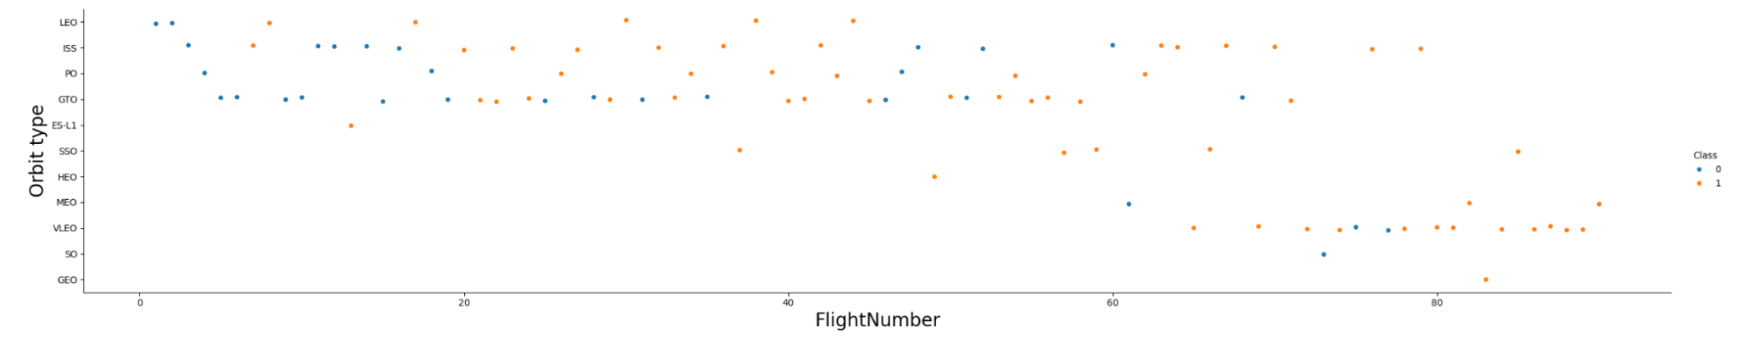
Flight Number vs. Orbit Type
VLEO seems to have been a recent admission that eclipsed some of the earlier types
SSO and HEO see very sporadic use but are always a success
Hard to establish any global correlation

Slide 22
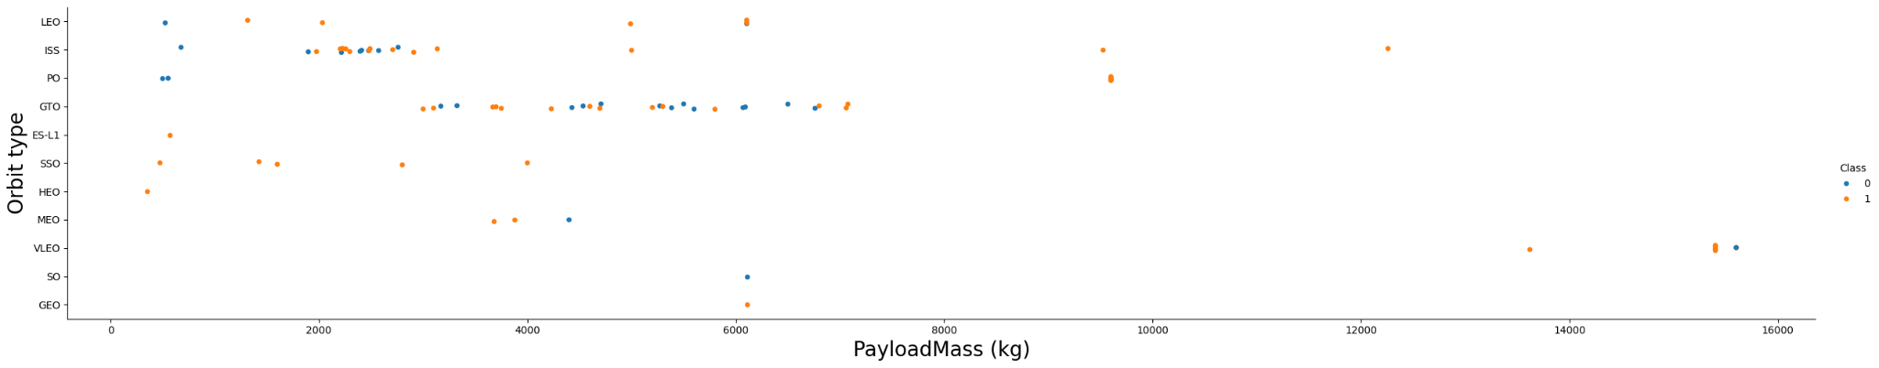
Payload vs. Orbit Type
GTO seems to only carry missions with very specific payload size (between 3000 and 7000 approx)
VLEO has only high payload size while SSO has only low one
Lower payload doesn’t necessarily equate to better success for the statistically significant orbit types

Slide 23
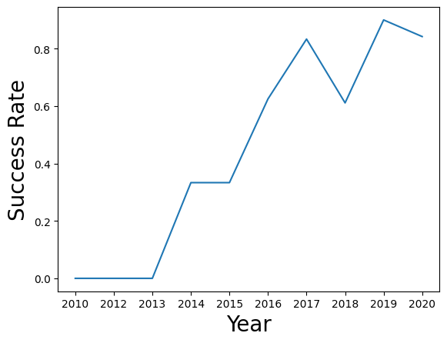
Launch Success Yearly Trend
Success Rate only goes up (except for 2018 and marginally for 2020)
2014 was a famous breakthrough with the first successes in SpaceX’s history

Slide 24
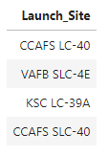
All Launch Site Names
%sql SELECT DISTINCT Launch_Site FROM SPACEXTABLE
Simple SELECT statement

Slide 25
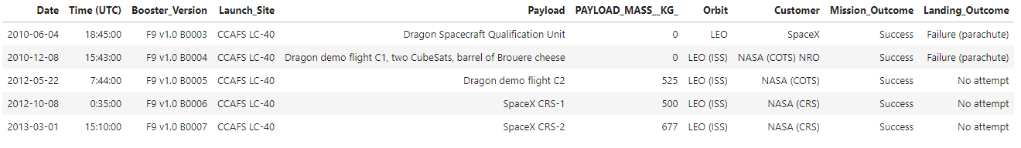
Launch Site Names Begin with 'CCA'
%sql SELECT * FROM SPACEXTABLE \
WHERE Launch_Site LIKE 'CCA%' \
LIMIT 5
The wildcard ‘%’ serves to select all launch sites beginning with something
LIMIT 5 to only print out the first 5 results

Slide 26
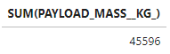
Total Payload Mass
%sql SELECT SUM(PAYLOAD_MASS__KG_) FROM SPACEXTABLE\
WHERE Customer = 'NASA (CRS)'
We select the aggregate SUM from the Payload Mass column
Context on the number of NASA (CRS) launches would be needed for this number to make sense

Slide 27
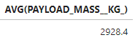
Average Payload Mass by F9 v1.1
%sql SELECT AVG(PAYLOAD_MASS__KG_) FROM SPACEXTABLE \
WHERE Booster_Version = 'F9 v1.1'
Same as before with AVG

Slide 28
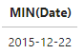
First Successful Ground Landing Date
%sql SELECT MIN(Date) FROM SPACEXTABLE \
WHERE Landing_Outcome = 'Success (ground pad)'
Same with MIN (works on Date formats)
This is the very famous ground pad success in 2015 that essentially re-put SpaceX on the map

Slide 29
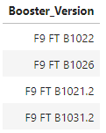
Successful Drone Ship Landing with Payload between 4000 and 6000
%sql SELECT Booster_Version FROM SPACEXTABLE \
WHERE Landing_Outcome = 'Success (drone ship)' AND PAYLOAD_MASS__KG_ BETWEEN 4000 AND 6000
BETWEEN is easier to write than writing out the two conditions
AND to bind multiple conditions

Slide 30
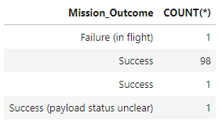
Total Number of Successful and Failure Mission Outcomes
%sql SELECT Mission_Outcome, COUNT(*) FROM SPACEXTABLE \
GROUP BY Mission_Outcome
GROUP BY to select by the different Mission Outcomes
Success is very common in this dataset

Slide 31
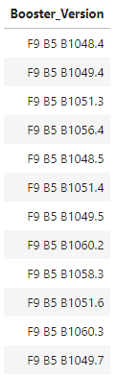
Boosters Carried Maximum Payload
%sql SELECT Booster_Version FROM SPACEXTABLE \
WHERE PAYLOAD_MASS__KG_ = (SELECT MAX(PAYLOAD_MASS__KG_) FROM SPACEXTABLE)
A Subquery is used since Max cannot be used outside the select statement for this task

Slide 32
2015 Launch Records
%sql SELECT substr(Date, 6,2) AS Month, * FROM SPACEXTABLE \
WHERE substr(Date,0,5) = '2015' AND Landing_Outcome = 'Failure (drone ship)' \
AND substr(Date, 6,2) IS NOT NULL \
ORDER BY Date
The functions used in the question are used to retrieve the months and year in MySQL
ORDER BY is ascending by default

Slide 33
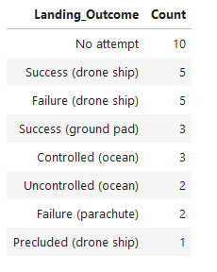
Rank Landing Outcomes Between 2010-06-04 and 2017-03-20
%sql SELECT LANDING__OUTCOME, COUNT(LANDING__OUTCOME) from SPACEXTBL \
WHERE DATE between '2010-06-04' and '2017-03-20' \
GROUP BY LANDING__OUTCOME \
ORDER BY LANDING_COUNT DESC;
BETWEEN can be used for dates

Slide 34

Section 3

Slide 35
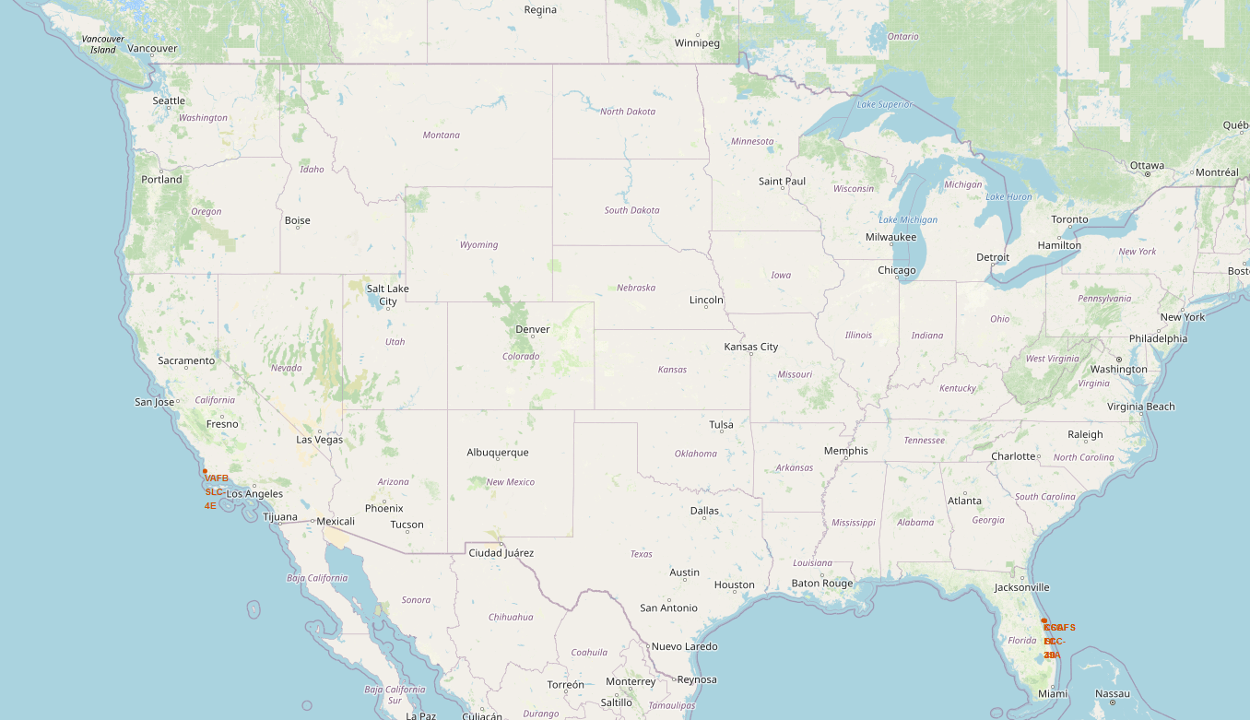
Launch Sites
Launch Sites in FL and CA
In the US only

Slide 36
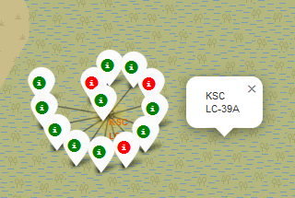
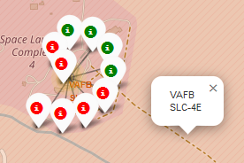
Successes and Failures
California launch site
Mostly successes
Florida launch site
Mostly failures

Slide 37
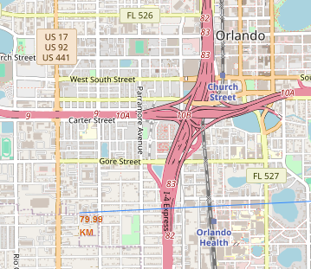
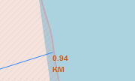
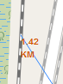
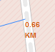
Proximity from Launch Sites
This is all taken from the CCAFS - LC 40 in California
In general, all launch sites are very close to the sea and to a means of transport (highway and/or railway)
City (Orlando)
Coastline
Highway
Railway

Slide 38

Section 4

Slide 39

Section 5

Slide 40
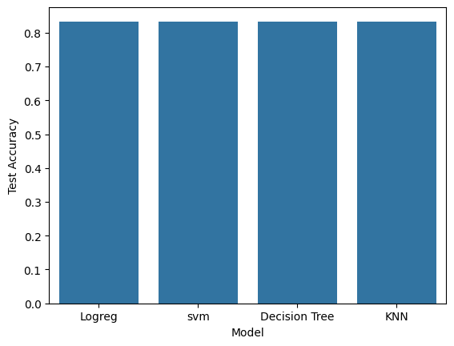
Classification Accuracy
With the deprecation of the ‘auto’ parameter of Decision Tree, all 4 models now have the same Test Accuracy (and Confusion Matrix…) on the test set
The Test set is quite small so this could’ve been expected

Slide 41

Confusion Matrix
This is the confusion matrix of all 4 models we have examined. We can see that the models only got 3 predictions wrong (False Positives or false alarm, the model seem ‘overconfident’ in a way.

Slide 42
Conclusions
From the EDA, we can see that important factors that could help the model in predicting success are the Launch sites, the size of the Payload and the Orbit Type. Time is also very much correlated with success, but this is not a real material, quantifiable factor.
A more thorough Explainable AI study would help in understanding the models’ decision
It’s always necessary to take a step back when analysis ML results.
Here, data is somewhat lacking, 18 test samples is too little to make an earnest analysis on the correct model to choose. This is due to the complex nature of the problem.
In real life situations, we would most likely test other models (given a more ample test set). This would help us discern between the models base on confusion matrices, ROC curves, AUC…

Slide 43


